Slide 1
Android UI Testing with Espresso
Presented by
Jim White
jpwhite_mn@yahoo.com

Slide 2
Tutorial Materials
Download setup instructions, class slides, & lab materials using Git from:
https://bitbucket.org/jpwhite_mn/andevcon2015boston

Slide 3


Introductions
Welcome to AnDevCon Boston & my Espresso training class!
Jim White
Software architect at
Trainer in Java, Android, open source, mobile development for ~15 years
Author, speaker, etc.

Slide 4

We can do better
There were 1.5 million Android apps as of May 2015
The average number of stars per app: 4.1
47% of apps crash > 1% of the time¹
Games crash 4.4% of the time¹
14% of user retention rate after downloading the app²
As a development community, we must do better!
Notes:
1 - http://www.infoq.com/news/2014/03/mobile_app_performance_benchmark
2 – Tapstream 2014, http://andrewchen.co/mobile-retention-benchmarks-for-2014-vs-2013-show-a-50-drop-in-d1-retention-guest-post/

Slide 5
Training Outline
Lesson 1: Background
What is Espresso
Why use Espresso
Lesson 2: How to get/setup Espresso
Hands on
Lesson 3: Espresso API basics
Hands on
Lesson 4: Advanced Espresso
Hands on
Lesson 5: Issues, Difficulties & Resources

Slide 6
Lesson 1: Background

Slide 7

Espresso (the framework)
What is Espresso?
Testing framework for writing user interface tests
Presented in 2013 (Google Test Automation Conference)
Created by Google
Used by Google (Maps, Drive, 30+ apps), Twitter, …
Latest version is 2.2
Requires Android 2.2 (API 8) or later
Project Web Site
https://code.google.com/p/android-test-kit/
Just Google-search “Android Espresso”

Slide 8

Espresso Foundation
What would a user do? How would they test an application?
They would…
Find a screen/widget they want to test
Interact with it
Check the results

Slide 9
Why use Espresso?
Simple
Find UI elements (Views) easily
Interact with them
Check some state on them
Without
Needing to get an activity, view details, etc.
Having to think about synchronization and response times
Trying to figure out how long to wait, sleep, etc.

Slide 10
More reasons to use Espresso
Speed
No needs for waits, syncs, sleeps, etc. as with other UI test frameworks
3x faster than Robotium per one benchmark¹
Reliable & Durable
Starts activities before the tests run and waits for any/all background work to finish
Tests that know how to wait/sync with non-UI resource processes
Refers to UI components by resource ID – if you prefer – to avoid string/language dependence in tests
Easy to setup
Via SDK Manager
Built on top of JUnit and Hamcrest Library
Extensible for more complex needs
Notes:
1 - http://www.stevenmarkford.com/android-espresso-vs-robotium-benchmarks/
Benchmark Robotium: 126.315 seconds (approx. 2500ms per iteration) Espresso: 44.701 seconds (approx. 900ms per iteration)

Slide 11
Android Testing Alternatives
JUnit3/4 & AndroidJUnitRunner
UI Automator
Robotium
Robolectric
Notes:
AndroidJUnitRunner: https://developer.android.com/tools/testing-support-library/index.html#AndroidJUnitRunner
UI Automator: https://developer.android.com/tools/testing-support-library/index.html#UIAutomator
Robotium: https://code.google.com/p/robotium/
Robolectric: http://robolectric.org/

Slide 12
Lesson 2: Setup

Slide 13
Lesson 2: Setup
Downloading Espresso with the SDK Manager
As of 2.0 version
Adding Espresso to your Android Studio Project
Device setup
There is Espresso for Eclipse with ADT
http://developer.android.com/tools/testing/testing_eclipse.html
Not part of our training today
Google ending Eclipse ADT support end of 2015
http://android-developers.blogspot.com.au/2015/06/an-update-on-eclipse-android-developer.html

Slide 14
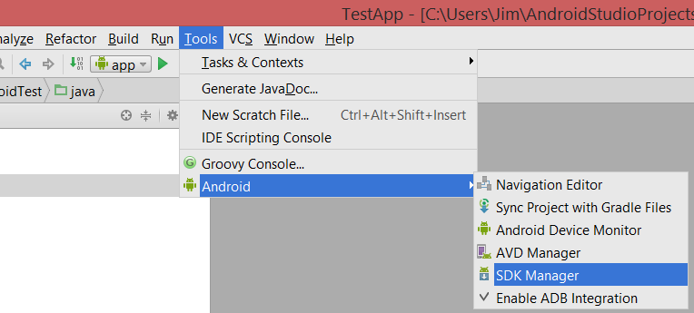
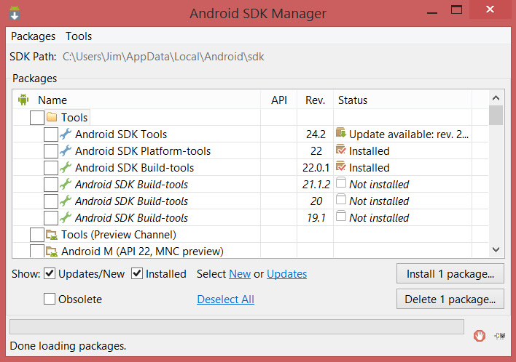
Downloading Espresso
Assuming Android Studio (AS) is installed
Ask your instructor for instructions if not
This is not part of our class today
Use the SDK Manager to get Espresso
It is included in the Android Support Repository
Android Support Repository rev 15 includes Espresso 2.2
Note: SDK Manager can be used independent of AS to get Espresso

Slide 15
Project Setup
Dependencies must be added to your AS project
Add Espresso and Android JUnit Runner packages to the build.gradle file
Note, add them to the app/build.gradle (not the top level build.gradle)
Indicate the instrumentation runner in the same file
Espresso runs on top of JUnit
Tests are executed through Android’s JUnit instrumentation runner

Slide 16
app/build.gradle additions
apply plugin: 'com.android.application'
android {
compileSdkVersion 22
buildToolsVersion "22.0.1"
defaultConfig {
applicationId "com.jwhite.mytest"
minSdkVersion 15
targetSdkVersion 22
versionCode 1
versionName "1.0"
testInstrumentationRunner "android.support.test.runner.AndroidJUnitRunner"
}
…
}
dependencies {
compile fileTree(dir: 'libs', include: ['*.jar'])
compile 'com.android.support:appcompat-v7:22.2.0'
androidTestCompile 'com.android.support.test.espresso:espresso-core:2.2'
androidTestCompile 'com.android.support.test:runner:0.3'
}
Add the test runner
Add the dependencies
Note, replace or remove older Espresso dependencies if you have them in your project (espresso-1.1-bundled.jar, etc.)

Slide 17
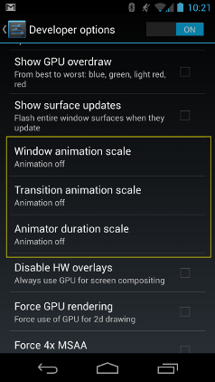
Device Setup
Espresso works best without animation
Most of our devices (physical or virtual) use animation by default
Turn off animation (via Settings) to “avoid flakiness” in your testing
This can also be done programmatically (in your testing code)
https://code.google.com/p/android-test-kit/wiki/DisablingAnimations
Avoids having to change the settings of your real device
But requires you run the code with each app

Slide 18

Lab 1
Start Android Studio
Get Android Support Repository
Create a test project
Add Espresso to the dependencies
Configure the device
Run a small test check

Slide 19
Lesson 3: Espresso API Basics

Slide 20
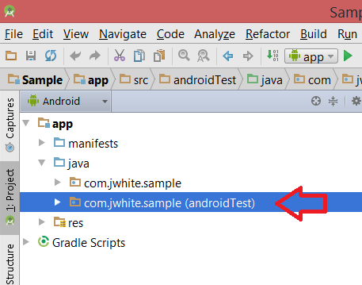
Lesson 3: Creating and Executing Espresso Tests
By default, Espresso test code has to be in the app/src/androidTest folder.
Created when you create the project.
Change the default through sourceSets in the project’s build.gradle
Espresso is built on top of JUnit (3 or 4 is allowed)
Espresso UI test cases are JUnit test cases
Typically, test each Activity (or Fragment) in a test case (i.e. test class)

Slide 21
JUnit4 Test Cases
test case = test class
When using Espresso with JUnit4…
Specify the instrumentation on the class (annotate with @RunWith)
Indicate the Activity under test (launched with the test) using @Rule
Specify test methods with @Test
Use the Espresso API in the test methods to exercise the UI
More on Android & JUnit:
https://developer.android.com/tools/testing/testing-tools.html

Slide 22
JUnit4 Espresso “Hello World"
@RunWith(AndroidJUnit4.class)
public class HelloEspresso {
@Rule
public ActivityTestRule<MyActivity> mActivityRule =
new ActivityTestRule(MyActivity.class);
@Test
public void checkForHelloWorld() {
onView(withText("Hello world!")).
check(matches(isDisplayed()));
}
}
Annotate the class with @RunWith
Indicate the activity under test with @Rule
Annotate test methods with @Test
Use Espresso

Slide 23
JUnit3 Test Cases
test case = test class
When using Espresso with JUnit3…
Extend ActivityInstrumentationTestCase2<YourActivity>
Use the constructor to specify the Activity type under test.
Provide a setup method to start the activity
Use methods that start with “test” to exercise the UI via Espresso.
NOTE: don’t try to mix JUnit4 and JUnit3 styles.

Slide 24
JUnit3 Espresso “Hello World"
public class HelloEspresso extends
ActivityInstrumentationTestCase2<MyActivity> {
public HelloEspresso () {
super(MyActivity.class);
}
@Override
public void setUp() throws Exception {
super.setUp();
injectInstrumentation(
InstrumentationRegistry.getInstrumentation());
getActivity();
}
public void testCheckForHelloWorld() {
onView(withText("Hello world!")).check(matches(isDisplayed()));
}
}
Extend ActivityInstrumentationTestCase2
Construct sets the activity under test
Setup method creates the activity instance (indirectly)
Test methods start with test
Use Espresso

Slide 25
Remember the Espresso Motto
Test like users would
Locate it
Take action
Check it
This simple motto helps in working with and remembering the Espresso API

Slide 26
Espresso (the class)
The starting point for UI interactions
Final class – cannot be extended
Initiate UI tests by first locating a UI component with static methods
onView - locates a View component on the display
onData - loads an adapter and then locates a View component (allows for dynamic data display)
Also allows for non-View related actions with static methods like pressBack.

Slide 27
Espresso’s Chief Components
The Espresso API has three very important types/components
These help to…
Locate a View (find the view displaying “Hello World”)
Take action on a View (click the “Done” button)
Check the state of a View (verify “Jim” is displayed in the TextView)

Slide 28
Espresso’s Big 3
Locate
Take action
Check the state
ViewMatcher
ViewAction
ViewAssertion

Slide 29
Typical Espresso API Formulas
ViewMatcher . ViewAction
Example: find this Button and click it
ViewMatcher . ViewAssertion
Example: find this EditText and check that it is enabled

Slide 30
ViewMatcher
Implements Matcher<View>
Hamcrest Matchers that locate a View component by…
Resource identifier
Class name
Whether it is displayed, enabled, has focus
Whether it is displaying some text
Etc.
To learn more about Hamcrest Matchers
http://www.slideshare.net/shaiyallin/hamcrest-matchers
https://code.google.com/p/hamcrest/wiki/Tutorial

Slide 31
ViewMatcher Example
allOf(withId(R.id.my_view), withText("Hello World!"), hasFocus())
Hamcrest Matcher
ViewMatcher

Slide 32
onView & onData with ViewMatchers
Espresso onView & onData use ViewMatchers to locate a View component of interest
Espresso.onView(allOf(withId(R.id.my_view), withText("Hello World!"), hasFocus()))
Espresso.onView(withId(R.id.ok_button))
Use onData with AdapterViews where the View may not exist/seen yet
// a Spinner shows a list of nationalities – some not yet displayed
Espresso. onData(allOf(is(instanceOf(String.class)), is(“Spanish")))

Slide 33
ViewAction
Once you have a View found by a ViewMatcher, you want to perform UI actions on that View.
ViewAction is responsible for performing an action (i.e. interaction) on a given View.
Use perform() method to invoke one or many ViewAction
onView(…).perform(click())
onView(…).perform(typeText())
Other ViewActions include: clearText, swipeLeft, swipeRight, longClick, pressKey, replaceText, scrollTo

Slide 34
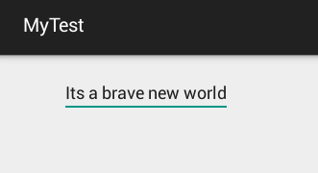
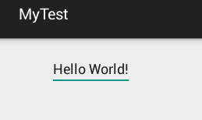
ViewAction Example
Espresso.onView(
allOf(withId(R.id.my_view), withText("Hello World!"), hasFocus()))
.perform(
replaceText(“It’s a brave new world.”));
ViewMatcher
Hamcrest Matcher
ViewAction

Slide 35
ViewAssertion
Once you have a View found by a ViewMatcher, ViewAssertion checks the state of that View
Does it have the right text?
Is the View displayed?
Typically done after activity displays or after performing an action
You may want to assert the state of the UI in a positive or negative case
Is displayed versus is not displayed
ViewAssertion use ViewMatchers & Hamcrest matchers.
to make sure a component is display
to make sure a View holds the right data
Use check() to assert a View state.

Slide 36
ViewMatcher with ViewAssertion Example
Espresso. onView(withId(R.id.my_view)).check(matches(isEnabled()));
ViewMatcher
ViewAssertion

Slide 37
ViewInteraction
perform() and check() are methods on ViewInteraction
ViewInteraction objects are returned by
calls to onView()
calls to perform()
calls to check()
Allows the calling of actions and assertions on views

Slide 38
ViewInteraction Example
Espresso. onView(withId(R.id.my_button)).perform(click());
ViewAction
ViewInteraction

Slide 39
onData
onView requires the target view to be in the view hierarchy.
Use onData instead of onView when matching against items in an AdapterView.
ListView
Spinner
AdapterView items may not be part of the view hierarchy when the test is executing
onData loads the items from the AdapterView first.

Slide 40
onData Example
Espresso.onData(withId(R.id.spinnertext_simple))
.check(matches(withText(containsString(“Spanish"))));

Slide 41
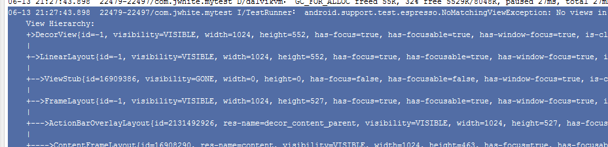
Logging
As Espresso deposits entries into the logcat about what it did.
I/ViewInteraction﹕ Performing 'replace text' action on view (with id: com.jwhite.mytest:id/my_view and with text: is "Hello World!" and has focus on the screen to the user)
When if fails, the view hierarchy is displayed in the exception

Slide 42

Lab 2
Test an Activity
Get Views with ViewMatcher
Perform actions with ViewAction
Check views with ViewAssertion
Use onData with Spinner
Inspect the logcat
Notes:
If your tests seem to fail, run with the device in portrait mode.

Slide 43
Lesson 4: Advanced Espresso

Slide 44
Topics to cover depending on time
Espresso Intents
Testing Asynchronous code
ServiceTestRule
Testdroid

Slide 45
Espresso Intents
Your
App
Intent
Another
App
Result
Intents are a valuable tool in Android communication
Launching another activity
Getting back results from an activity
Since you can’t control the external app, confirming intents fired and getting results back is difficult in unit testing.
With the latest versions, Espresso offers a Mockito-like mechanism to work with Intents
Espresso records all intents launch from the activity under test
Assert that the intent was sent
Stub result responses from external activities to the activity under test

Slide 46
Espresso Intents Setup
Requires Android Support Repository 2.2 (SDK Manager)
Dependent on Espresso 2.1 or better
Add an additional dependency to your app/build.gradle
androidTestCompile 'com.android.support.test.espresso:espresso-intents:2.2‘
Use IntentsTestRule versus ActivityTestRule

Slide 47
Espresso Intent Validation
public class MyIntentTest {
@Rule
public IntentsTestRule<MyActivity> mActivityRule =
new IntentsTestRule<>(MyActivity.class);
@Test
public void triggerIntentTest() {
// click of button fires intent
onView(withId(R.id.calc_button)).perform(click());
// assertion check that intent actually fired
Intents.intended(IntentMatchers.toPackage(
"com.android.calculator2"));
}
}
Replace ActivityTestRule with IntentTestRule
Check the intent fired to the target package

Slide 48
Espresso Intent Stubbing
public class MyIntentTest {
@Rule
public IntentsTestRule<MyActivity> mActivityRule =
new IntentsTestRule<>(MyActivity.class);
@Test
public void activityResult_IsHandledProperly() {
Intent resultData = new Intent();
String expectedString = "ABC123EQT";
resultData.putExtra("customer_id", expectedString);
ActivityResult result = new ActivityResult(
Activity.RESULT_OK, resultData);
intending(toPackage("com.jwhite.otherapp")).
respondWith(result));
onView(withId(R.id.customerButton)).perform(click());
onView(withId(R.id.customerId).
check(matches(withText(expectedString)));
}
}
Build the fake result to mimic real activity for result return
Register the stub to respond when an intent to the other app is seen.
User action that results in the other app activity being launched and stub returned.
Check that the “returned” stub data shows up in the view.

Slide 49
Testing Asynchronous Code
This has always been the hard part of Android unit testing.
In other frameworks, after making some asynch request from the UI…
Build in arbitrary waits or sleeps
Wait for a signal from the asynchronous processing to the testing harness
Poll to see if the processing is done
By default, Espresso already waits for …
UI events in the current message queue to process
AsyncTasks to complete

Slide 50
Espresso and other asynchronous processing
Espresso provides a means to register other long running operations
Example: calls to web services via separate thread (like Volley)
Espresso calls these IdlingResources (an interface)
IdlingResource objects are essentially semaphore objects
A CountingIdlingResource implementation is provided in espresso.contrib
After registering an IdlingResource
Espresso checks in with the resource to make sure it is idle before exercising the UI
If the resource is busy, it waits

Slide 51
IdlingResource Example
public class TestResource implements IdlingResource {
ResourceCallback callback;
@Override
public String getName() {
return “your resource name";
}
@Override
public boolean isIdleNow() {
// return true if the resource is idle, false if busy
}
@Override
public void registerIdleTransitionCallback(ResourceCallback resourceCallback) {
// the callback is registered with Espresso to allow it to be notified of a idle transition
this.callback = resrouceCallback;
}
public void onUpdate() {
callback.onTransitionToIdle();
}
}
Implement IdlingResource
Provide getName, isIdleNow and registerIdleTransitionCallback methods
When resource becomes idle, inform the callback

Slide 52
Register the IdlingResource
@Test
public void testSomething() {
Espresso.registerIdlingResource(new TestResource());
onView(withId(R.id.startServiceButton)).perform(click());
onView(withId(R.id.service_filled_view).
check(matches(withText(expectedString)));
}
Register the idling resource with Espresso (only needs to be done once)
Espresso will likely pause here as it waits for the resource to do its work and become idle again.

Slide 53
ServiceTestRule
Not really a Espresso thing – its an Android Testing Support Library thing
Added with Espresso 2.1
Offers a mechanism to start a service before a test and stop them after a test
The service can be started in a bound or unbound way.

Slide 54
Register the IdlingResource
@RunWith(AndroidJUnit4.class)
public class ServiceUsingTest {
@Rule
public final ServiceTestRule serviceRule =
new ServiceTestRule();
@Test
public void testWithService() throws TimeoutException{
serviceRule.startService(
new Intent(InstrumentationRegistry.getTargetContext(),
MyBackgroundProcessingService.class));
// test code
onView(withId(R.id.someButton)).perform(click());
…
}
}
Use ServiceTestRule; extend it to have your own initialization and clean up
Start the service

Slide 55

Testdroid
Mobile software development/testing company
Testdroid Cloud
Allows you to upload your app and Espresso unit tests to the cloud
Exercise your tests on a variety of platforms
Explore for free
How-to: http://testdroid.com/news/how-to-use-espresso-v2-0-with-testdroid-cloud-devices

Slide 56
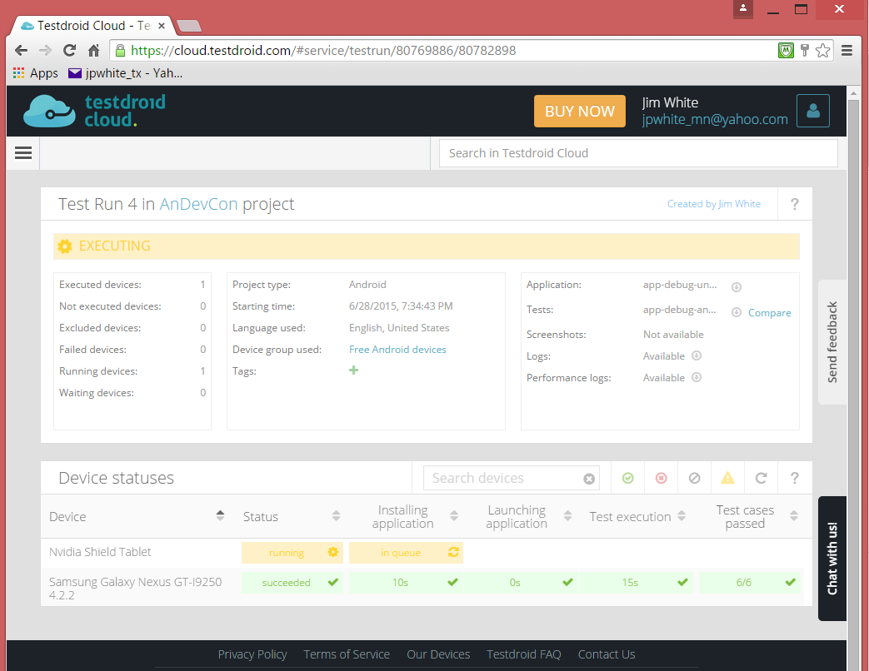
Testdroid demo

Slide 57

Lab 3
Use Espresso Intents to get a contact
Call on a service for data in Espresso using Service Test Rule
Optionally – look at the app in Testdroid

Slide 58
Lesson 5: Issues, Difficulties & Resources

Slide 59

No Perfect World
Espresso has made Android UI testing easier, faster, more reliable
It’s not perfect
You will find some issues with these and more:
Toast and other 3rd party alerting packages like Crouton
EditText.setError
Keyboards that cover the UI (don’t forget landscape, portrait modes)
SoftKeyboard close doesn’t
Try double close of the keyboard
Animation on some platforms
Note Espresso Issues Wiki
https://code.google.com/p/android-test-kit/issues/list

Slide 60
Android Support Test Annotations
Filter annotations provide some help/relief for problematic tests
Android.support.test.filters
FlakyTest – used to filter out a test on execution
RequiresDevice – execute the test only if running on a physical device
SdkSuppress – execute the test if running on a particular device

Slide 61
Resources to-go
Espresso Project
https://code.google.com/p/android-test-kit/
Android/Google Testing Training
https://developer.android.com/training/testing/ui-testing/espresso-testing.html
Testdroid
http://testdroid.com/
Tutorials
http://www.stevenmarkford.com/android-ui-testing-with-espresso-basics-tutorial/
http://www.stevenmarkford.com/testing-fragments-with-android-espresso-basic-example/
http://www.vogella.com/tutorials/AndroidTestingEspresso/article.html
https://www.youtube.com/watch?v=qtKx1WxK7cw
https://medium.com/@marta/ui-tests-with-espresso-android-studio-c476d3b5ba45
https://androidresearch.wordpress.com/2015/04/04/an-introduction-to-espresso/

Slide 62

eventmobi.com/adcboston
Please take a moment to fill out the class feedback form via the app. Paper feedback forms are also available in the back of the room.

Slide 63
Thank you
Enjoy the rest of the conference!
Don’t forget to fill out the evaluation sheet.
jpwhite_mn@yahoo.com

